Slide 1
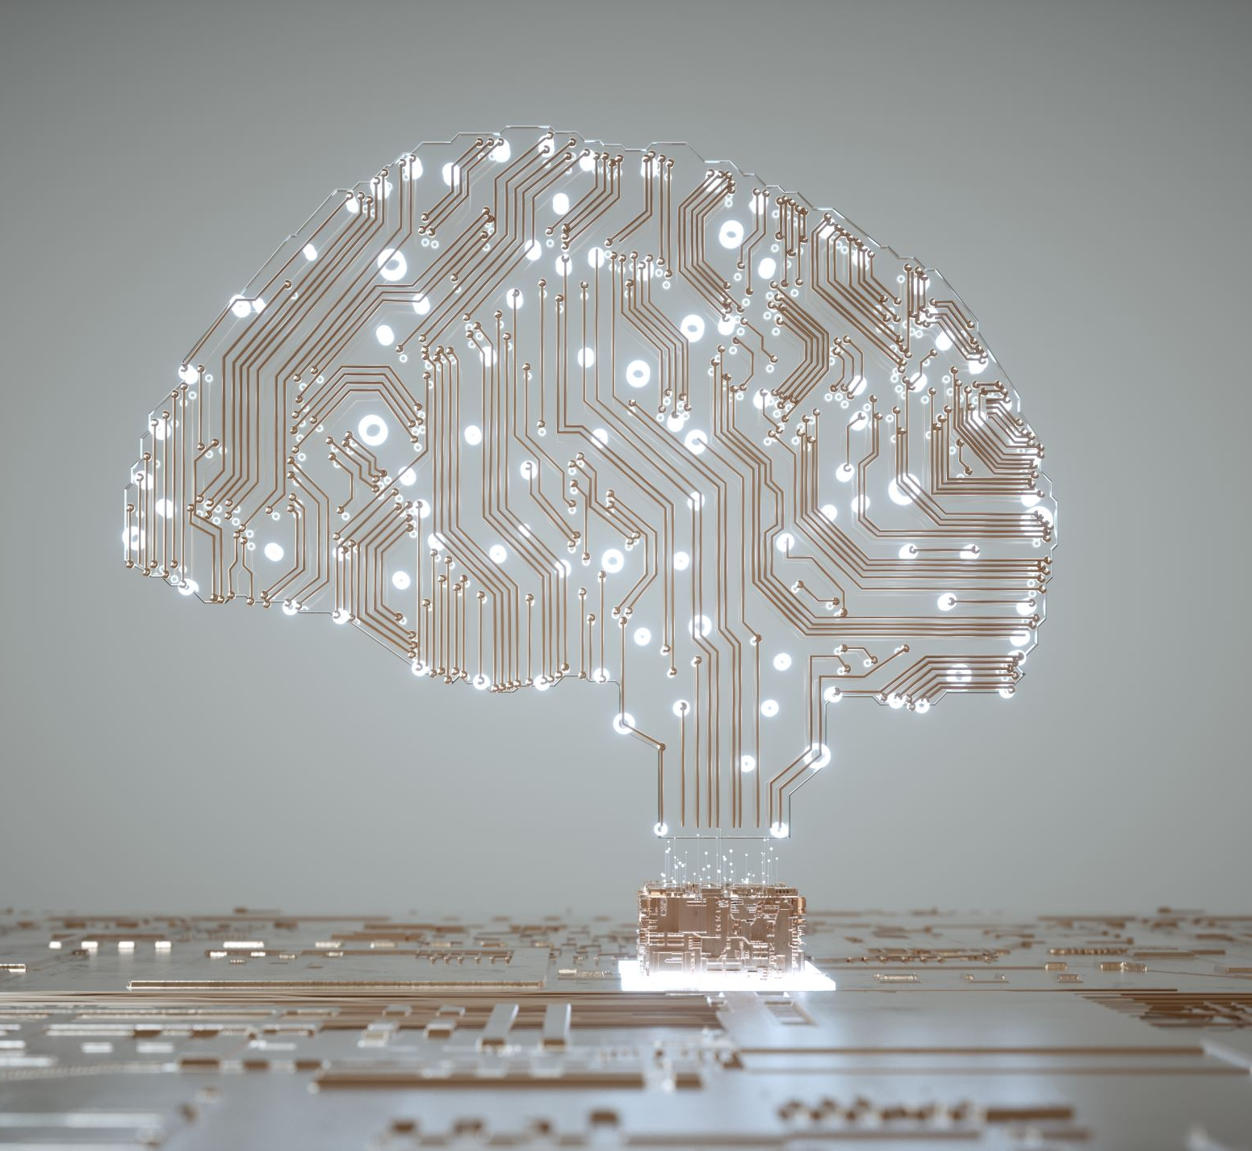
AI FOR DATA SCIENCE
(20CS2221PA)
By:
K.venkata sree sai

Slide 2
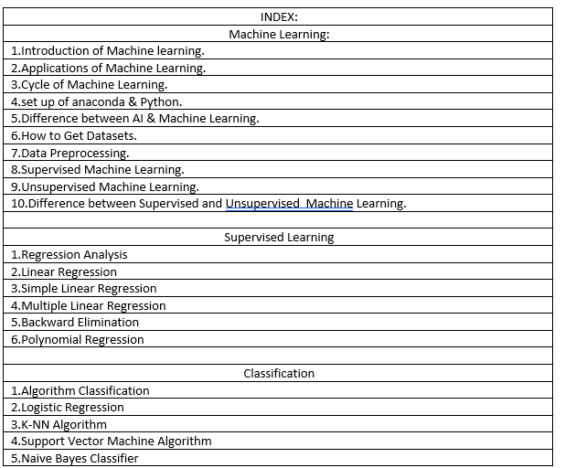
INDEX:

Slide 3

1.Introduction to Machine Learning:

Slide 4
Topics :
Introduction of Machine Learning.
What is the Machine Learning.
How does Machine Learning Work.
Features of Machine Learning.
Needs for Machine Learning.
Classifications .
At present Machine Learning.

Slide 5
Introduction of Machine Learning.
Machine learning is a growing technology which enables computers to learn automatically from past data.
Machine learning uses various algorithms for building mathematical models and making predictions using historical data or information. Currently, it is being used
for various tasks such as image recognition, speech recognition, email filtering, Facebook auto-tagging, recommender system,
and many more.

Slide 6
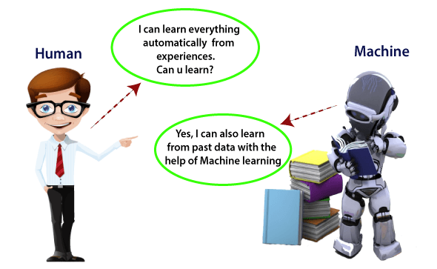
What is Machine Learning?
An algorithm that has ability to learn from past experience is called Machine learning ..

Slide 7
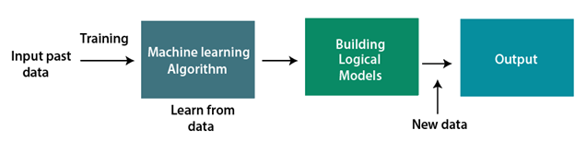
2.How does Machine Learning Work.
A Machine Learning system learns from historical data, builds the prediction models, and whenever it receives new data, predicts the output for it. The accuracy of predicted output depends upon the amount of data, as the huge amount of data helps to build a better model which predicts the output more accurately.

Slide 8
Machine learning uses data to detect various patterns in a given dataset.
It can learn from past data and improve automatically.
It is a data-driven technology.
Machine learning is much similar to data mining as it also deals with the huge amount of the data.
Features of Machine Learning:

Slide 9
Need for Machine Learning
Rapid increment in the production of data
Solving complex problems, which are difficult for a human
Decision making in various sector including finance
Finding hidden patterns and extracting useful information from data.

Slide 10
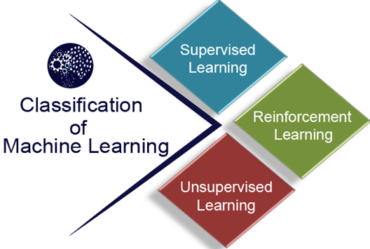
Classification of Machine Learning
Supervised learning
Unsupervised learning
Reinforcement learning

Slide 11
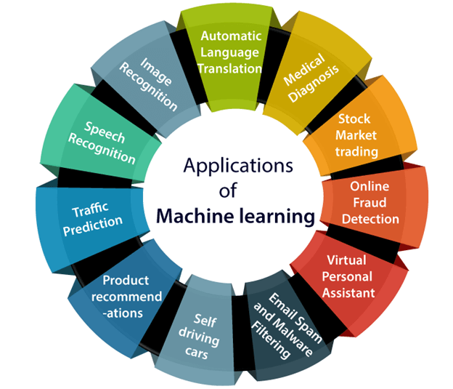
Applications of Machine learning

Slide 12
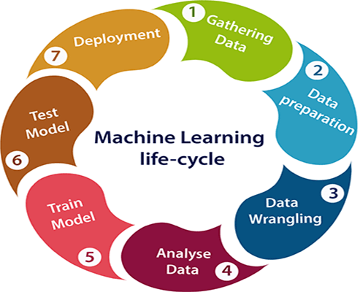
Machine learning Life cycle

Slide 13
Artificial Intelligence (AI) and Machine learning (ML):
Artificial Intelligence
Machine learning
It is a technology which enables a machine to simulate human behavior.
The goal of AI is to make a smart computer system like humans to solve complex problems.
In AI, we make intelligent systems to perform any task like a human.
Machine learning and deep learning are the two main subsets of AI.
It is a subset of AI which allows a machine to automatically learn from past data without programming explicitly.
The goal of ML is to allow machines to learn from data so that they can give accurate output.
In ML, we teach machines with data to perform a particular task and give an accurate result.
Deep learning is a main subset of machine learning.

Slide 14
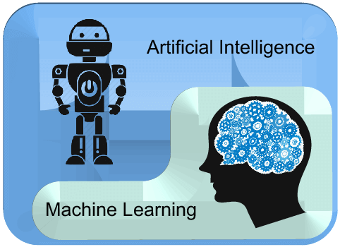
Continutions…..
‘’AI is a bigger concept to create intelligent machines that can simulate human thinking capability and behavior, whereas, machine learning is an application or subset of AI that allows machines to learn from data without being programmed explicitly.’’

Slide 15
How to get datasets for Machine Learning.
The key to success in the field of machine learning or to become a great data scientist is to practice with different types of datasets. But discovering a suitable dataset for each kind of machine learning project is a difficult task. So, in this topic, we will provide the detail of the sources from where you can easily get the dataset according to your project

Slide 16
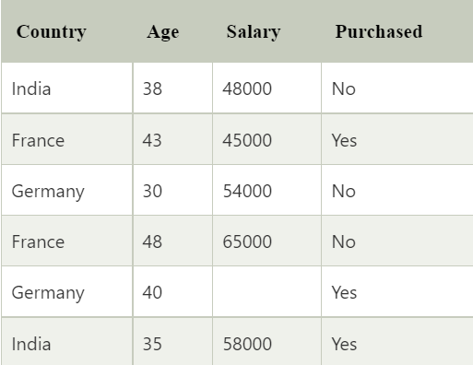
What is a dataset?
A dataset is a collection of data in which data is arranged in some order. A dataset can contain any data from a series of an array to a database table. Below table shows an example of the dataset:

Slide 17

Data Preprocessing
It is a process of preparing the raw data and making it suitable for a machine learning model. It is the first and crucial step while creating a machine learning model.

Slide 18
Steps Involved in Data Preprocessing
Getting the dataset
1
Importing libraries
2
Importing datasets
3
Finding Missing Data
4
Encoding Categorical Data
5
Splitting dataset into training and test set
6
Feature scaling
7

Slide 19


